Slide 1


Read & Publish
Open Access initiative
Article submission guide for corresponding authors at participating institutions

Slide 2
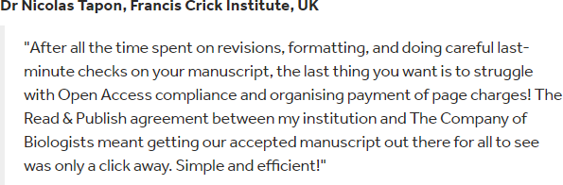
Free Open Access publishing under our Read & Publish initiative
Corresponding authors at institutions participating in our Read & Publish initiative can publish accepted research articles immediately Open Access without charge in Development, Journal of Cell Science, Journal of Experimental Biology
See participating institutions

Slide 3
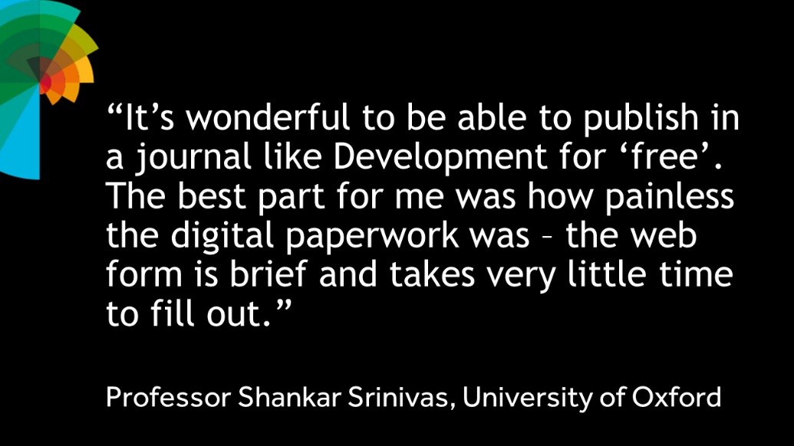
Free Open Access publishing under our Read & Publish initiative (2)
The affiliation of the corresponding author is used to determine eligibility for Read & Publish Open Access fee waivers, so please ensure that the corresponding author is agreed before you start the submission process.

Slide 4
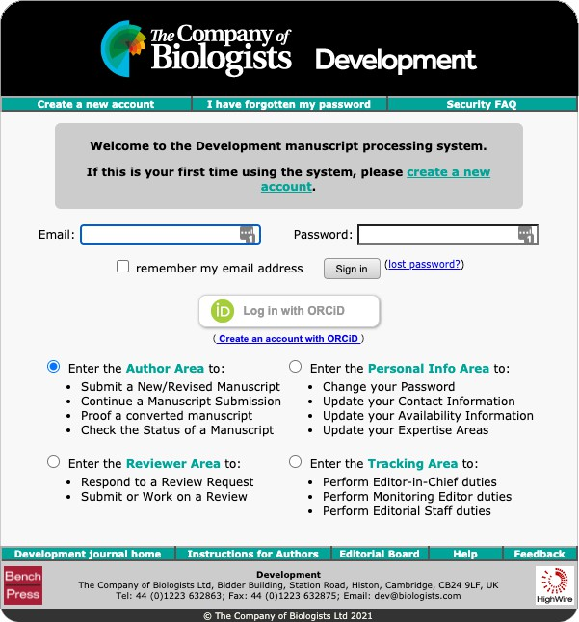
Which journal would you like to submit your research article to?
Select the journal you would like to submit your research article to:
Biology Open: https://submit-bio.biologists.org/
Development: https://submit-dev.biologists.org/
Disease Models & Mechanisms: https://submit- dmm.biologists.org/
Journal of Cell Science: https://submit-jcs.biologists.org/
Journal of Experimental Biology: https://submit- jeb.biologists.org/
We use Bench>Press for article submissions. If you already have an account, log in using your existing username and password. If you are a new user, you will need to create an account.
When you have logged in, select “Enter the Author Area”.

Slide 5


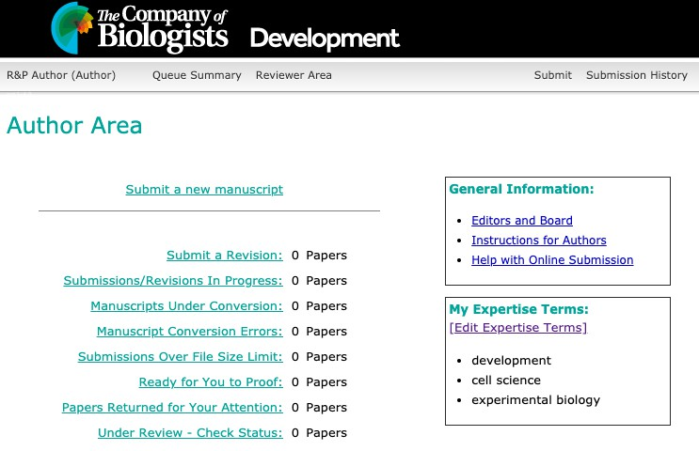

Start the submission process
Once you are in the Author Area, click the “Submit a new manuscript” link.

Slide 6

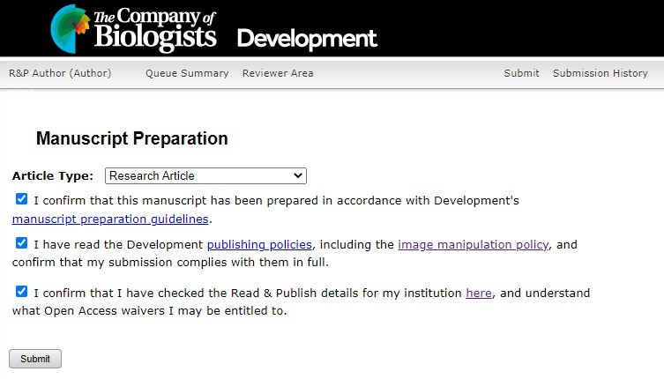
Specify article type
Select your article type in the “Article Type” dropdown.
Confirm you have read the journal manuscript guidelines, publishing policies and Read & Publish details.
Click “Submit”.

Slide 7
Author submissions – article types
Authors can only publish ‘Original Research Articles’ under the Read & Publish agreement.
‘Original Research Articles’ include: Research Article, Research Report, Techniques and Resources Article, Techniques and Resources Report, Short Report, Tools and Resources, Methods & Techniques, Short Communication, Resource Article, Theory & Modelling, Resources & Methods.
‘Original Research Articles’ do not include: Review Papers, Commentaries, Correspondence, Corrections, Additions, Posters or any other content or material.

Slide 8

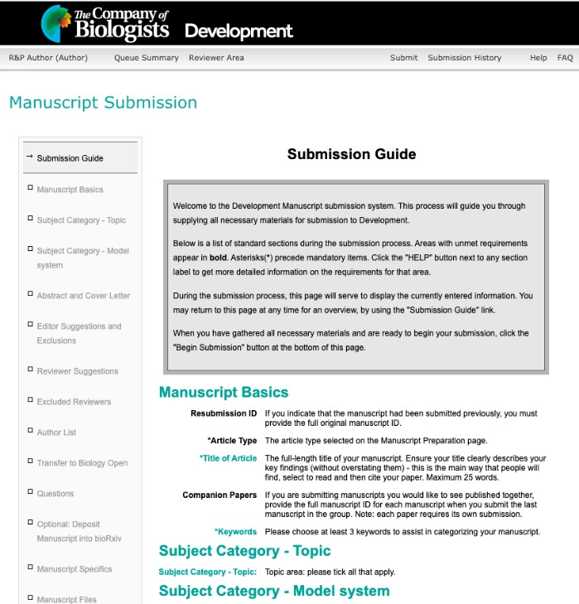

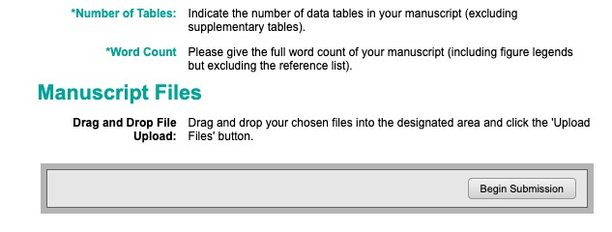
Read the Manuscript Submission Guide
You will then see the Manuscript Submission Guide.
When you have read it, click “Begin Submission at the bottom of the page.

Slide 9

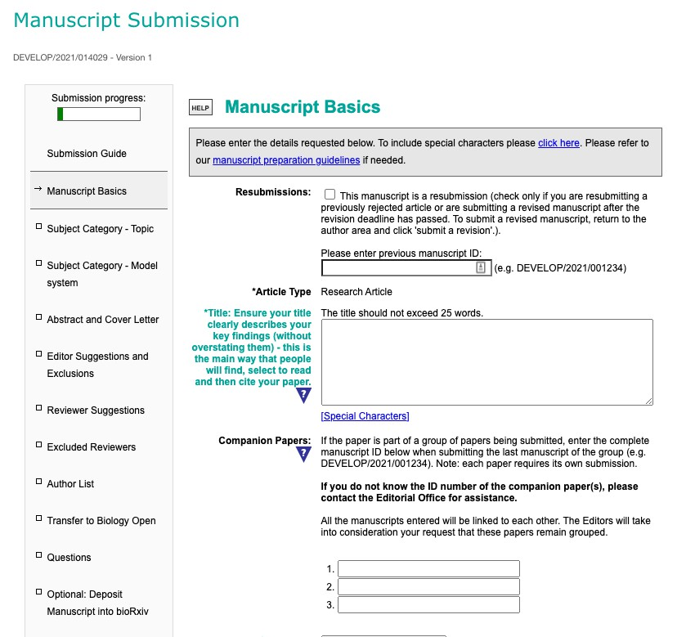
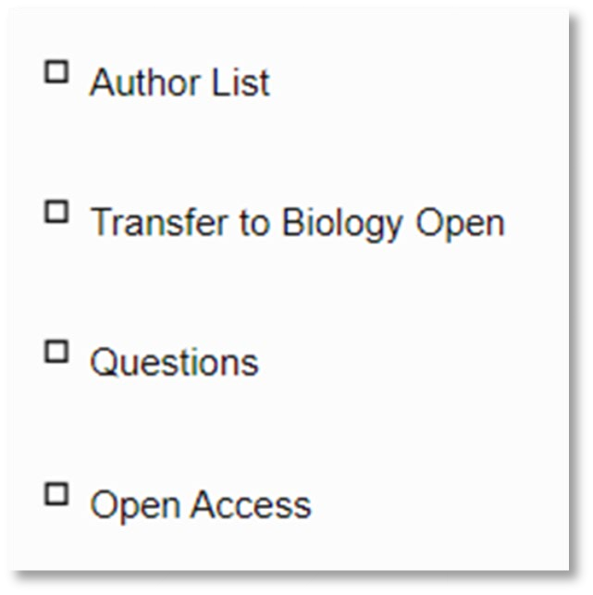
Work through all sections of the submission process
You need to complete all sections of the submission process.
For submissions under the Read & Publish agreement, you need to pay particular attention to the “Author List” and “Open Access” sections.

Slide 10

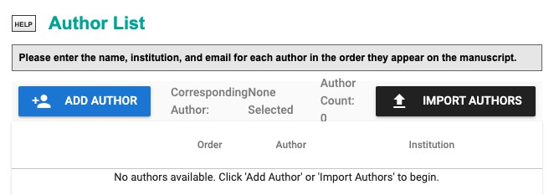

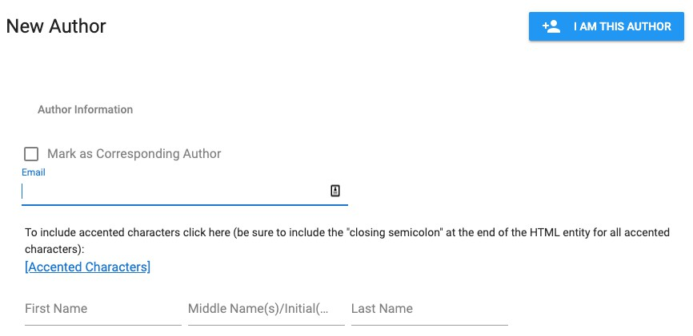
The “Author List” section
You need to add the name, institution and email for each author in the “Author List” section.
You also need to specify the corresponding author for your article.
To qualify for fee-free Open Access publishing, the corresponding author must be affiliated with an institution which is participating in our Read & Publish initiative.

Slide 11

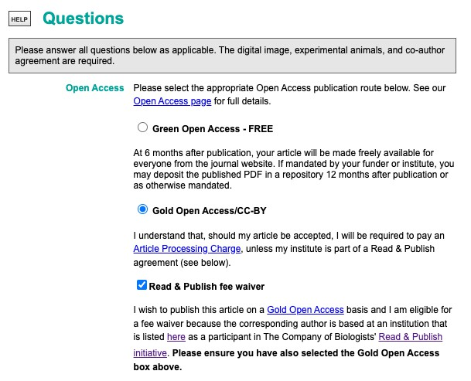
The “Open Access” section
If your article is eligible for free Open Access publication under a Read & Publish agreement with a participating institution, select “Gold Open Access/CC-BY” and “Read & Publish fee waiver” in the “Questions” section of the submission process.

Slide 12

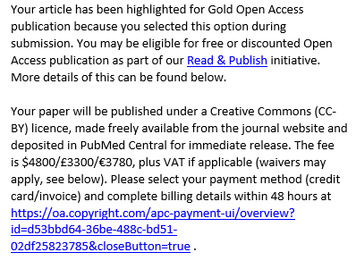
Post-submission peer review
Once you have submitted your article, it will undergo peer review.
We will let you know by email whether your article has been accepted for publication.
If it has been accepted, you will need to sign and return the Publication Agreement in your Bench>Press “Author Area”.
We will then email you a link to our RightsLink system and, if the institution of the corresponding author is participating in our Read & Publish agreement, an automatic fee-waiver will be applied.

Slide 13

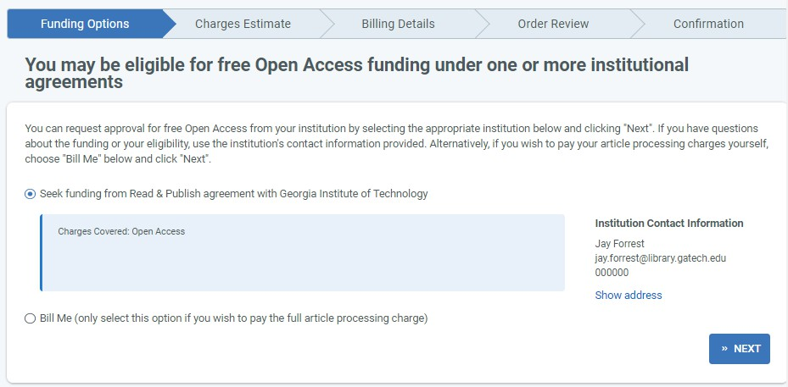

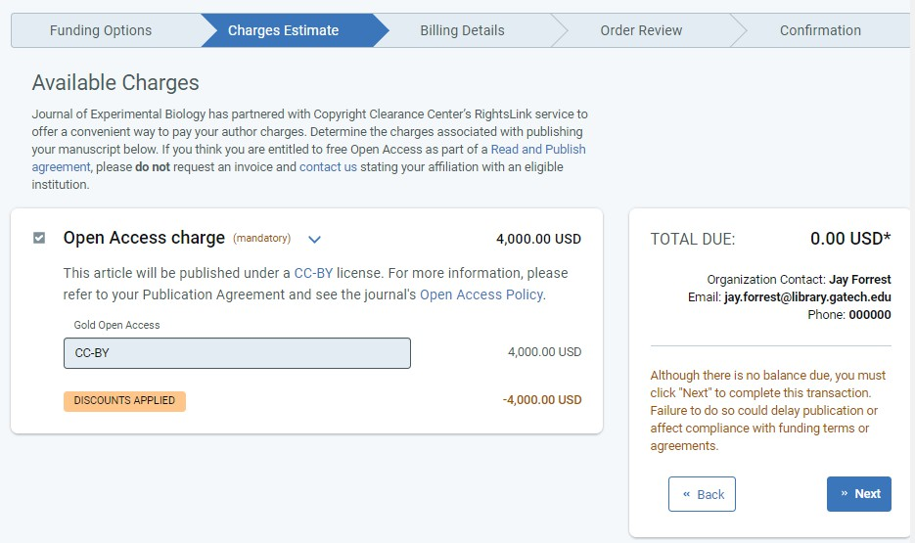
RightsLink payment system
You will be taken to the sign in page of our RightsLink Open Access payment system.
If you already have an account, log in using your existing username and password. If you are a first-time user, you will need to create an account.
Select “Seek funding from [name of institution]” and then click “next”.

Slide 14
Confirmation of free Open Access publishing
You will receive a confirmation email as soon as the corresponding authors’ institution confirms eligibility for free OA publishing under their Read & Publish agreement with us.
A PDF proof of your article will be sent to you for review, and the final approved version will be published under an Open Access CC-BY license.

Slide 15
Promote and share your article
Your article will be published Open Access.
This means you can share it as widely as you like (via social media and scholarly collaboration networks, by email, in your teaching etc) in the knowledge that everyone worldwide – regardless of their institution’s licensing arrangements – can read it and share it further.

